Slide 1

End-to-End State Management for Offline-First Web Applications
Michael L Perry @michaellperry
Jinaga jinaga.com
with Jinaga
github.com michaellperry/sharedlist

Slide 2
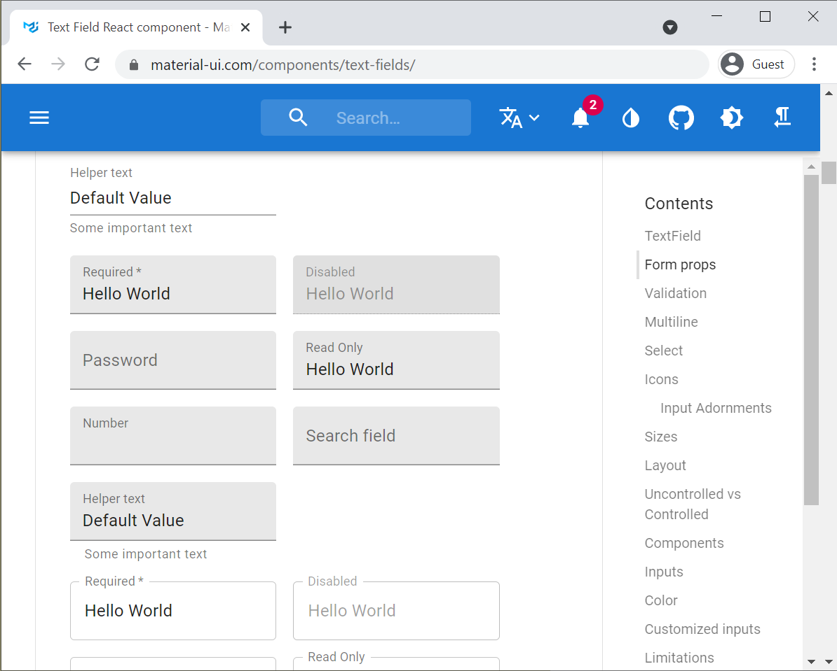
Typical State Management
{
"acts": [{
"actGuid": "xxx",
"title": "Fluffy"
}],
"venues": [{
"venueGuid": "yyy",
"name": "Starplex"
}]
}
POST /acts/47/description
{
"title": "Fluffy",
"imageHash": "7XB29Z6"
}
ActGuid | Title | ImageHash
B12045A8 | Jeff Foxworthy | IueU1qWeH
520A6D1C | Gabriel Iglesias | KD58ewv7n
520A6D1C | Fluffy | MqnLxHgd2Ne5w
B12045A8 | Jeff Dunham | IueU1qWeH6Kk

Slide 3
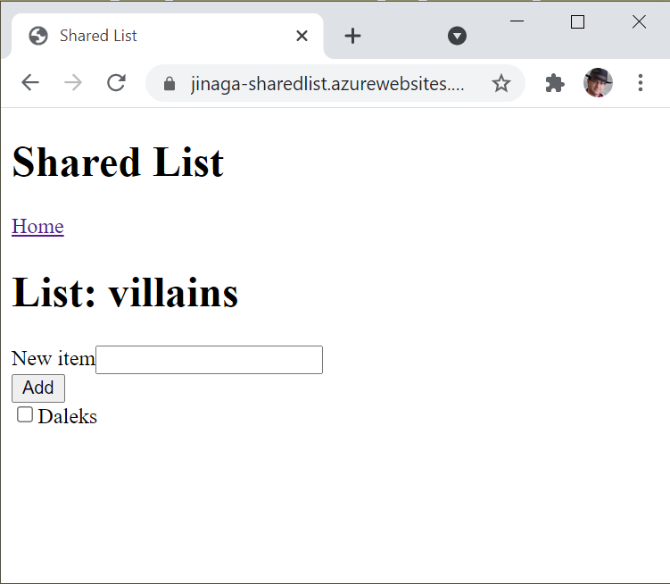
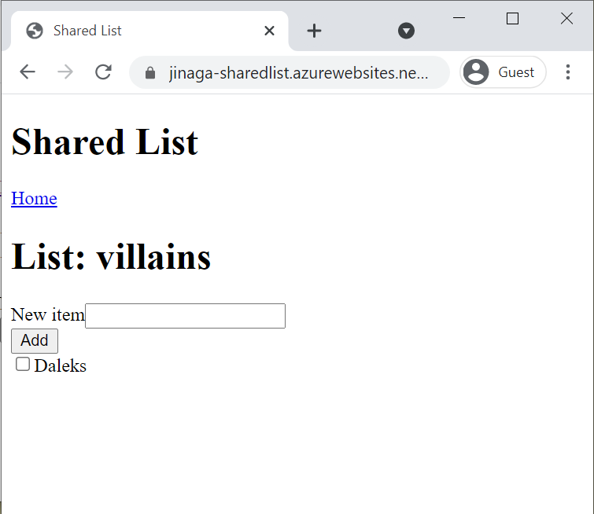
Shared List
https://jinaga-sharedlist.azurewebsites.net/
https://github.com/michaellperry/sharedlist
Notes:
https://jinaga-sharedlist.azurewebsites.net/
https://github.com/michaellperry/sharedlist

Slide 4
Typical Storage
CREATE TABLE ActDescription(
ActDescriptionId int IDENTITY(1,1) NOT NULL,
ActId int NOT NULL,
ModifiedDate datetime2(7) NOT NULL,
Title nvarchar(100) NOT NULL,
ImageHash nvarchar(88) NULL,
CONSTRAINT PK_ActDescription PRIMARY KEY CLUSTERED
(
ActDescriptionId ASC
),
CONSTRAINT AK_ActDescription_ActId_ModifiedDate UNIQUE NONCLUSTERED
(
ActId ASC,
ModifiedDate ASC
)
dotnet ef migration add AddedActDescription
POST /acts/47/description
{
"title": "Fluffy",
"imageHash": "7XB29Z6"
}
INSERT INTO ActDescription
(ActId, ModifiedDate, Title, ImageHash)
VALUES (47,GETUTCDATE(),'Fluffy','7XB29Z6')

Slide 5
Jinaga Storage
const list = await j.fact({
type: "SharedList.List",
topic: "villains"
});
const item = await j.fact({
type: "SharedList.Item",
list,
description: "Daleks",
created: new Date()
});

Slide 6
Typical Retrieval
GET /acts/47/description
SELECT ActGuid, Title, ImageHash
FROM Act a
JOIN ActDescription d
ON d.ActId = a.ActId
{
"actGuid": "B12045A8",
"title": "Fluffy",
"imageHash": "7XB29Z6"
}
const actResponse = await fetch(`/act/${actId}/description`);
const act = await actResponse.json();
const actSlice = createSlice({
name: "act",
initialState: act,
reducers
})

Slide 7
Jinaga Retrieval
function itemsInList(list) {
return j.match({
type: "SharedList.Item",
list
});
}
const items = await j.query(list,
j.for(itemsInList));

Slide 8
Typical Binding
store.dispatch({
type: 'COMPLETE_TODO’,
index: 1
});
function todos(state = [], action) {
switch (action.type) {
case 'COMPLETE_TODO’:
return state.map((todo, index) => {
})
}
}
const todo = useSelector(state =>
state.todos.find(todo => todo.id === todoId)
)

Slide 9
Jinaga Binding
const itemProjection = projectionFor(Item, {
item: field(i => i),
description: field(i => i.description)
});
export const itemComponent = mapProps(itemProjection).to(
({item, description}) => (
<div>
<label>
<input type="checkbox"
onChange={e => j.fact(new Completed(item))}
/>
{description}
</label>
</div>
)
);

Slide 10


Typical Collaboration
// Server-side code
io.on("connection", socket => {
socket.send("Hello!");
});
// Client-side code
socket.on("message", data => {
store.dispatch({
type: "INCOMING_MESSAGE",
data
});
});

Slide 11
Jinaga Collaboration
const list = new List(topic);
React.useEffect(() => {
const subscription = j.subscribe(list,
j.for(Item.inList));
return () => {
subscription.stop();
}
}, [topic]);

Slide 12

Typical Offline
//check for support
if (!("indexedDB" in window)) {
console.log("This browser doesn't support IndexedDB");
return;
}
const db = awaot idb.open("festify", 1, function (upgradeDb) {
if (!upgradeDb.objectStoreNames.contains("acts")) {
upgradeDb.createObjectStore("acts", { keyPath: "actGuid" });
}
});
const tx = db.transaction("acts", "readwrite");
const store = tx.objectStore("acts");
store.add(act);
tx.complete();

Slide 13
Jinaga Offline
export const j = JinagaBrowser.create({
httpEndpoint: "/jinaga",
indexedDb: "sharedlist"
});

Slide 14
Jinaga State Management
Storage
await j.fact({
type: "SharedList.List",
topic: "villains"
});
Specification
function itemsInList(list) {
return j.match({
type: "SharedList.Item",
list
});
}
Projection
const itemProjection = projectionFor(Item, {
item: field(i => i),
description: field(i => i.description)
});
Subscription
j.subscribe(list, j.for(itemsInList));
Offline
export const j = JinagaBrowser.create({
httpEndpoint: "/jinaga",
indexedDb: "sharedlist"
});

Slide 15
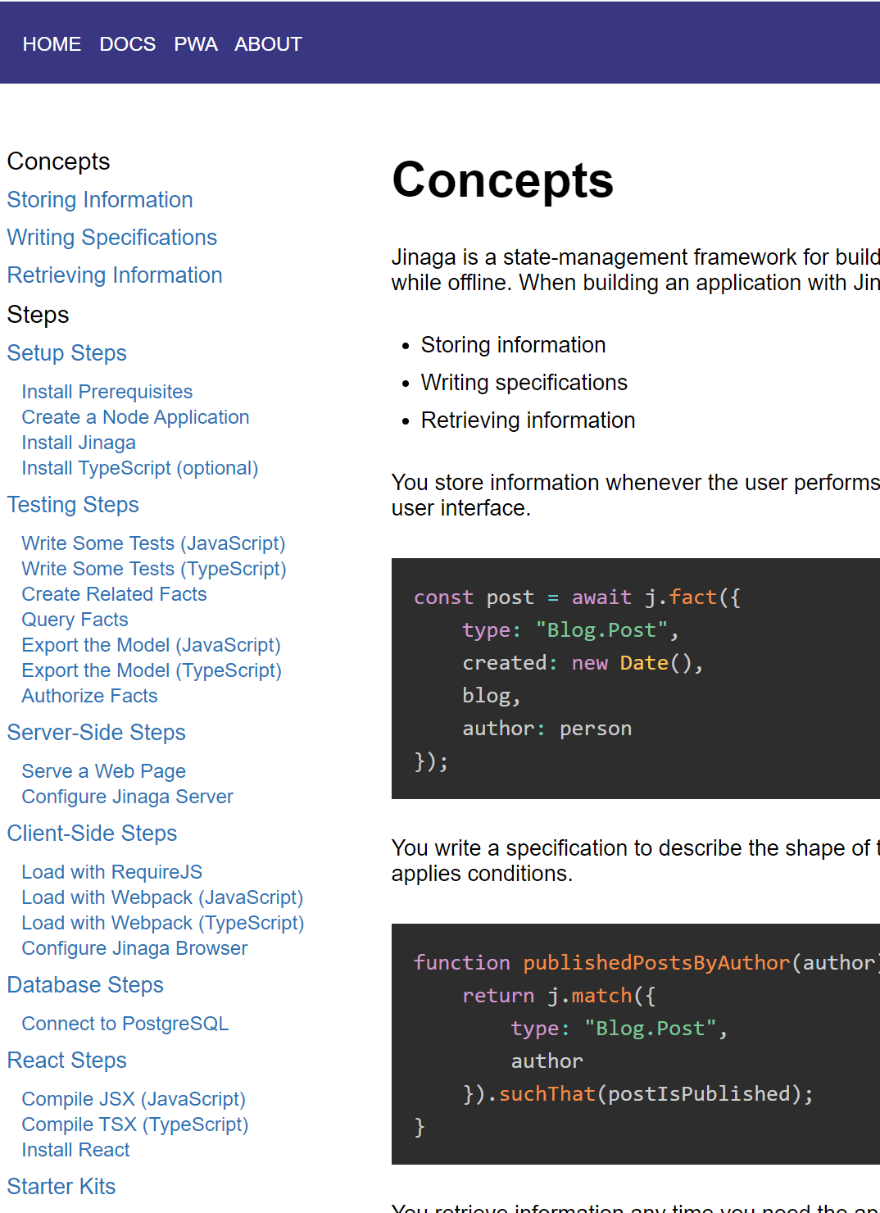
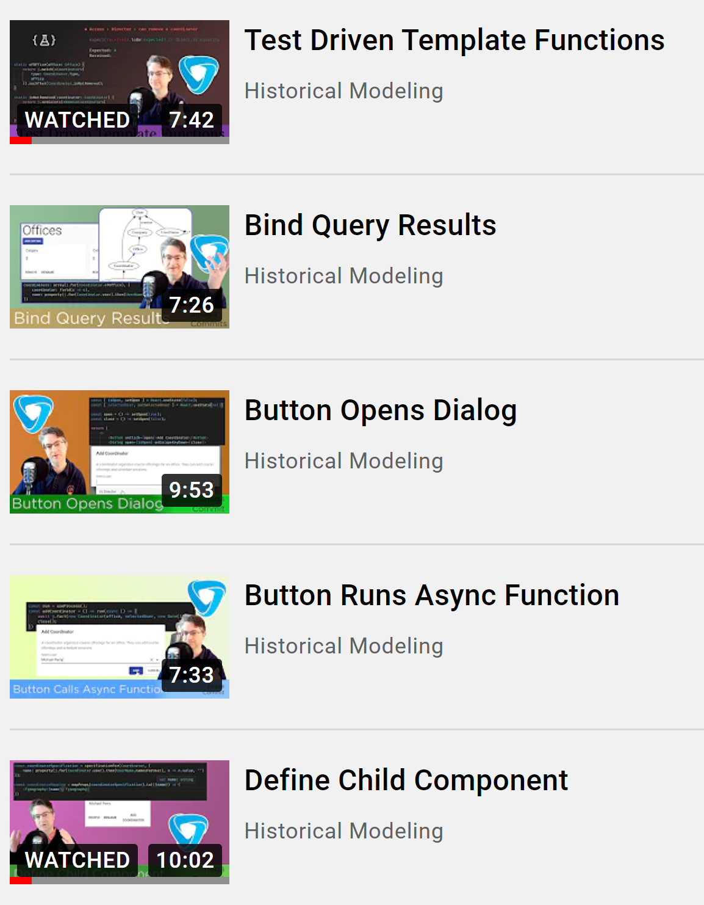
Jinaga.com
Michael L Perry @michaellperry

